Slide 1
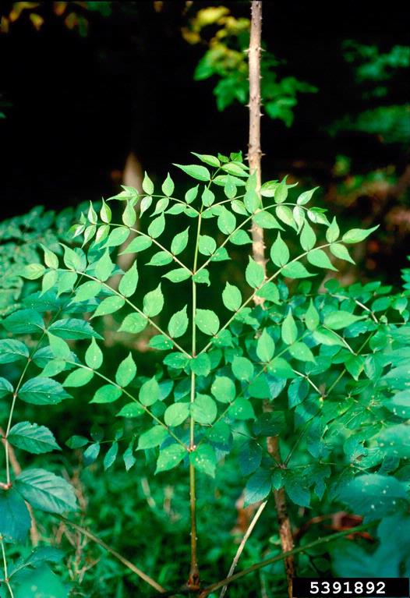

How to use species distribution modeling to study the past spread and predict future spread of non-native species
Matthew E. Aiello-Lammens, PhD
Department of Environmental Studies and Science
Photo: John M. Randall, The Nature Conservancy, Bugwood.org

Slide 2
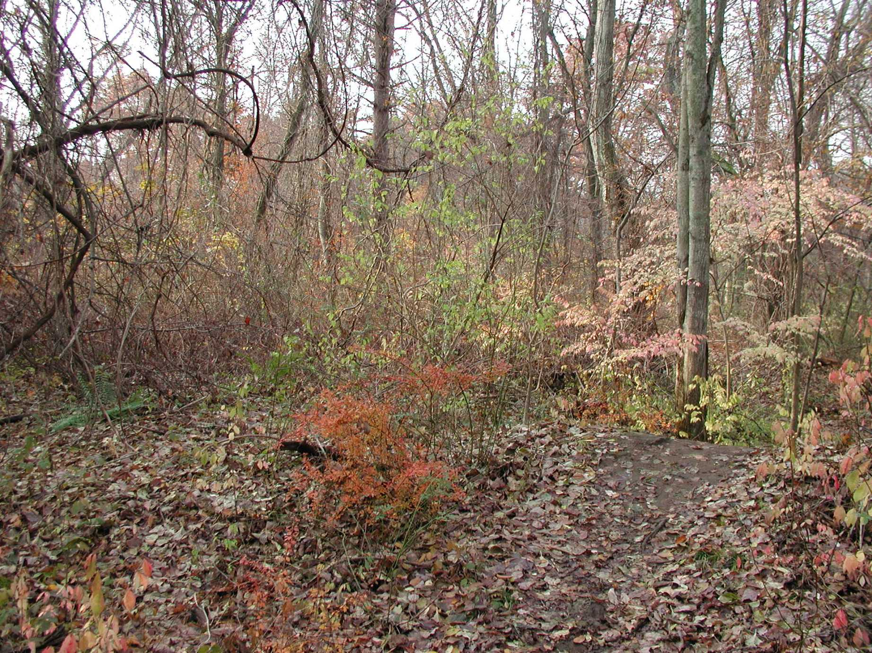
Invasive plants seem to thrive in our forests
Oriental bittersweet
Burning bush
Morrow’s honeysuckle
Japanese honeysuckle
Japanese barberry
Norway maple
Garlic mustard
Slender bittercress
Dame’s rocket
Notes:
Nine different invasive species growing here!

Slide 3
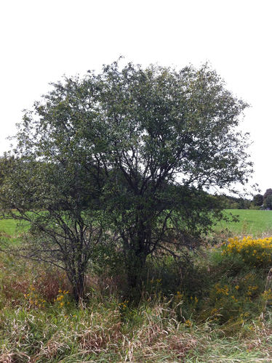
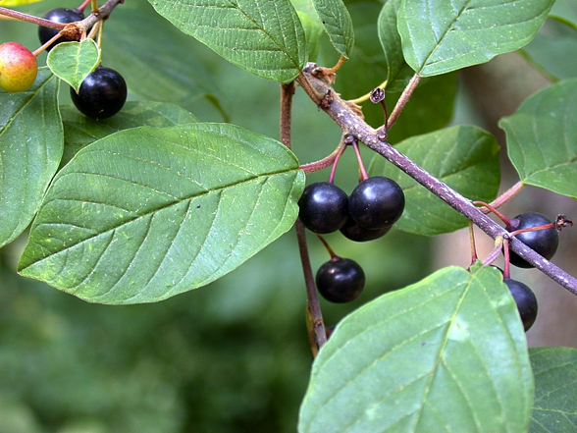
Frangula alnus (Glossy buckthorn)
(syn. Rhamnus frangula)
Rapid spread assumed to result from bird dispersed fruit
Notes:
This is also very often given as one reason buckthorn has spread so rapidly in the novel range

Slide 4
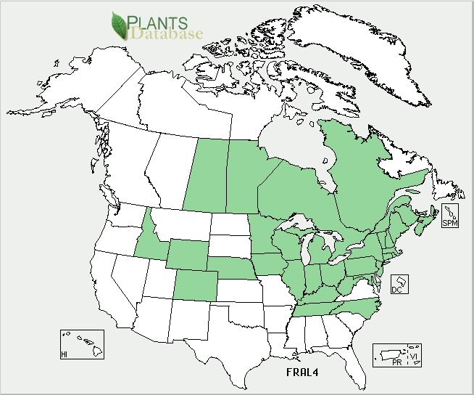
Frangula alnus (Glossy buckthorn)
Notes:
Distribution and abundances of organisms

Slide 5
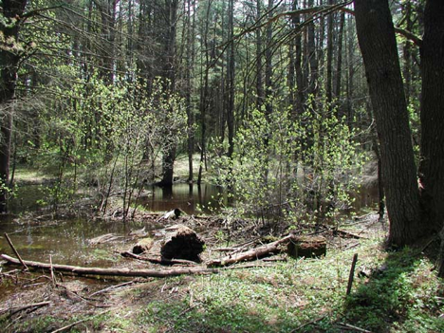
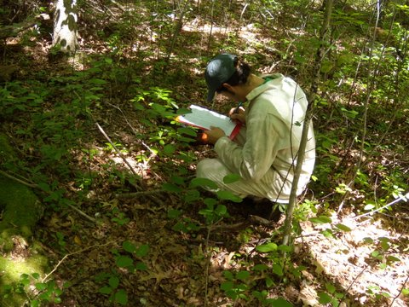
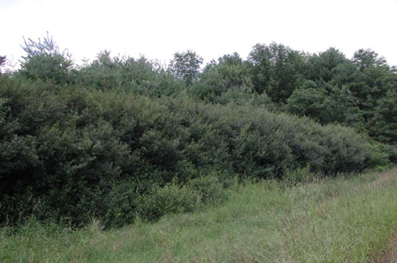
Habitat generalist
Primarily a mid-successional species, but shade tolerant
Growth facilitated by disturbance

Slide 6
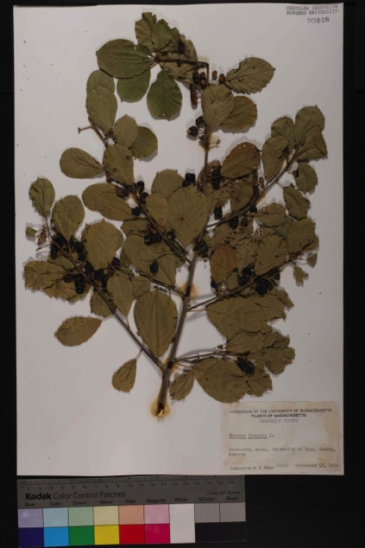
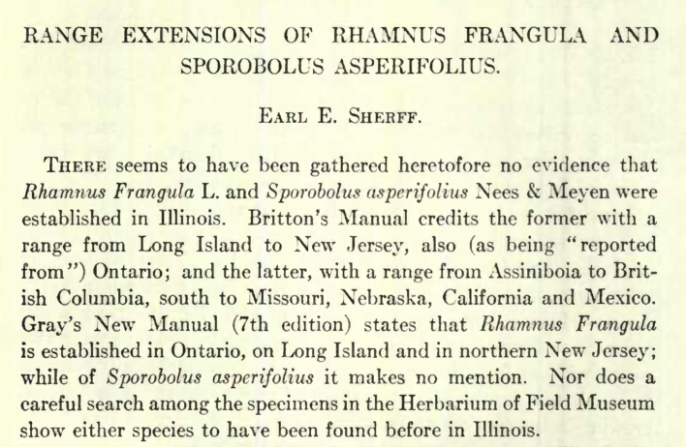
Using natural history records to reconstruct the pattern of spatial spread
Published accounts
Herbarium specimens
Total of 740 occurrences
Collect historic occurrence records

Slide 7
Notes:
By 1880 there is a single occurrence here in northern New Jersey

Slide 21
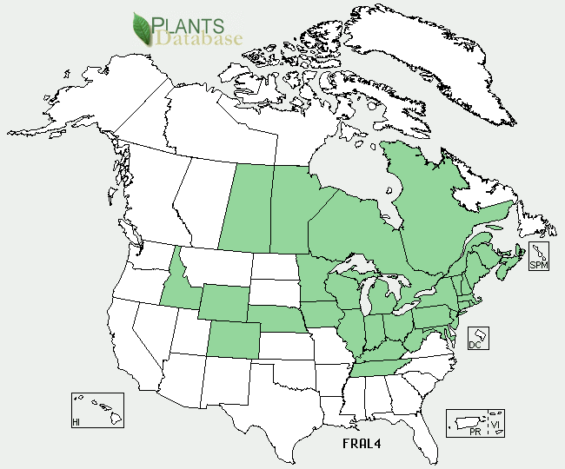
Identifying species distributions
Frangula alnus
Future Distribution?
Notes:
What methods do we have to identify a species distribution?
For the remainder of the talk, I'm going to refer to the species Frangula alnus (Glossy buckthorn), because it was the focus of my PhD work.

Slide 22
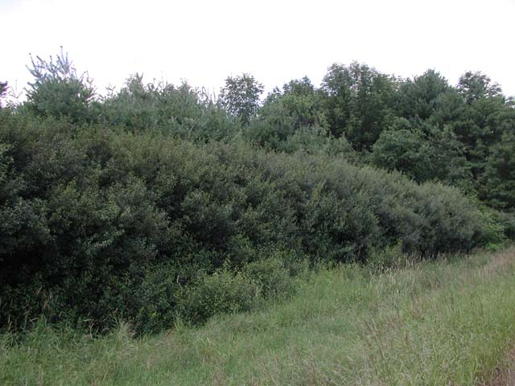

Species distribution model
Glossy buckthorn is observed in …
Old fields
Wetlands
Full to partial sun light (but not deep understories)

Slide 23
Species distribution model
Glossy buckthorn is observed in …
Prob(suitable for GB) ~
Sun light + Land cover + Soil moisture

Slide 24
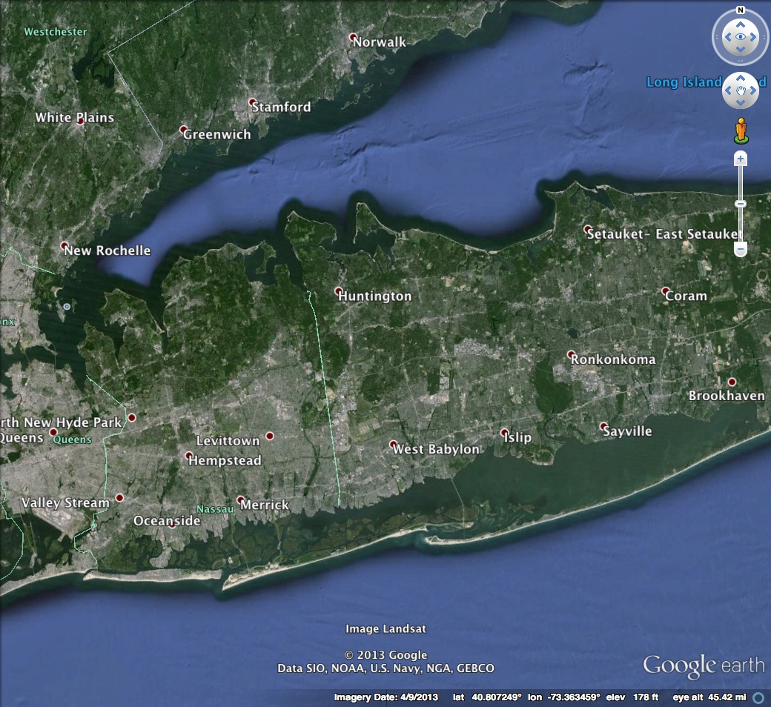
Species distribution model

Slide 25
Species distribution model
Notes:
What I’m talking about here are pretty site specific conditions

Slide 26
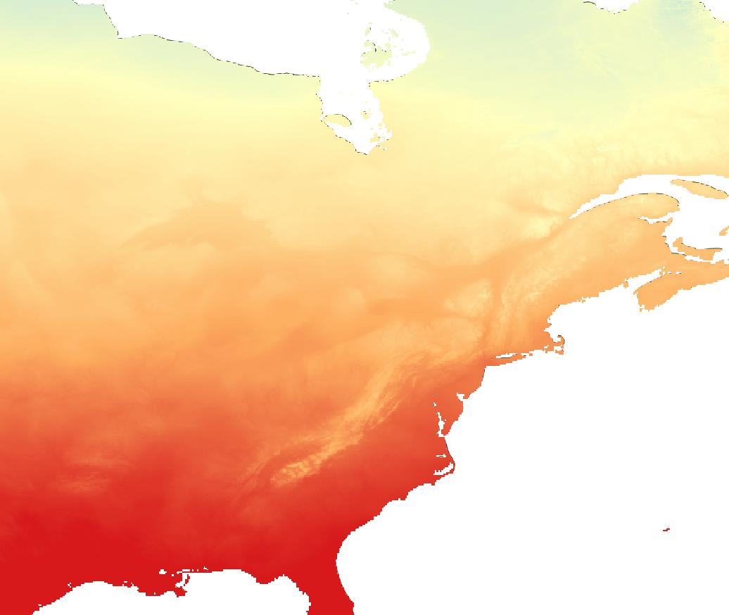
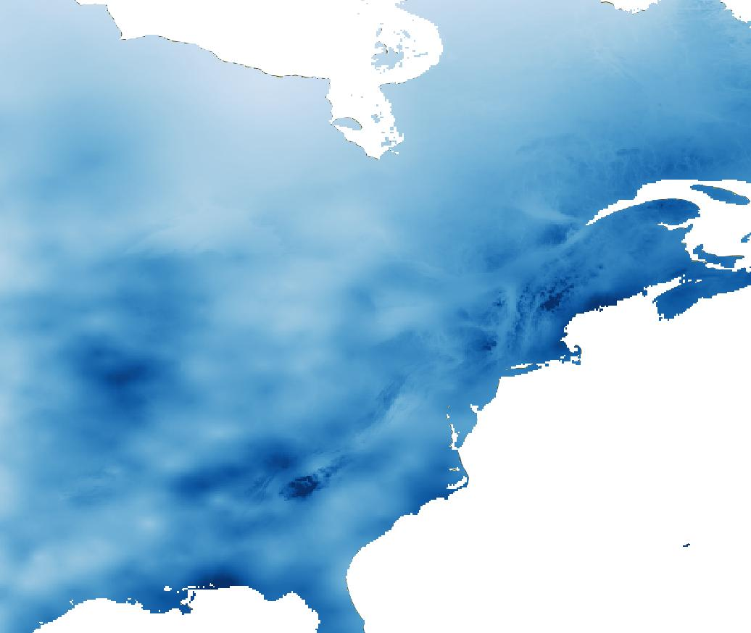
Species distribution model
Mean Annual
Temperature
Total
Precipitation
Notes:
We know that at large scales weather and climate patterns also play a role in shaping the distribution of glossy buckthorn

Slide 27

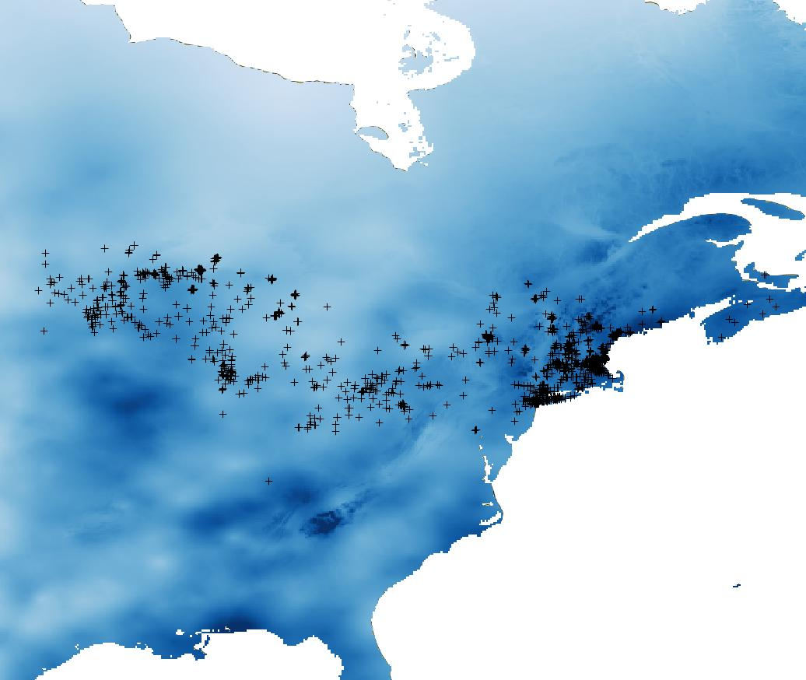
Species distribution model
GB Presence =
Mean Annual Temperature + Total Precipitation + …
Notes:
Black dots are observed presence locations

Slide 28
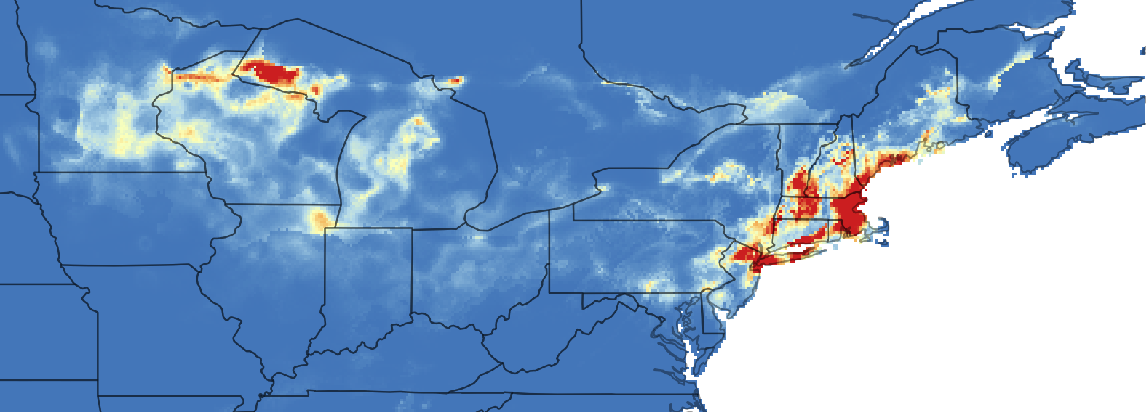
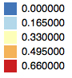
Species distribution model
GB Suitability ~
Mean Annual Temperature + Total Precipitation + …

Slide 29
Uses of species distribution models
The data required to construct these models are relatively easy to get
On-line databases like EDDMaps, iNaturalist, iMapInvasives
Climate layers easy to get, other environmental variables also accessible

Slide 30
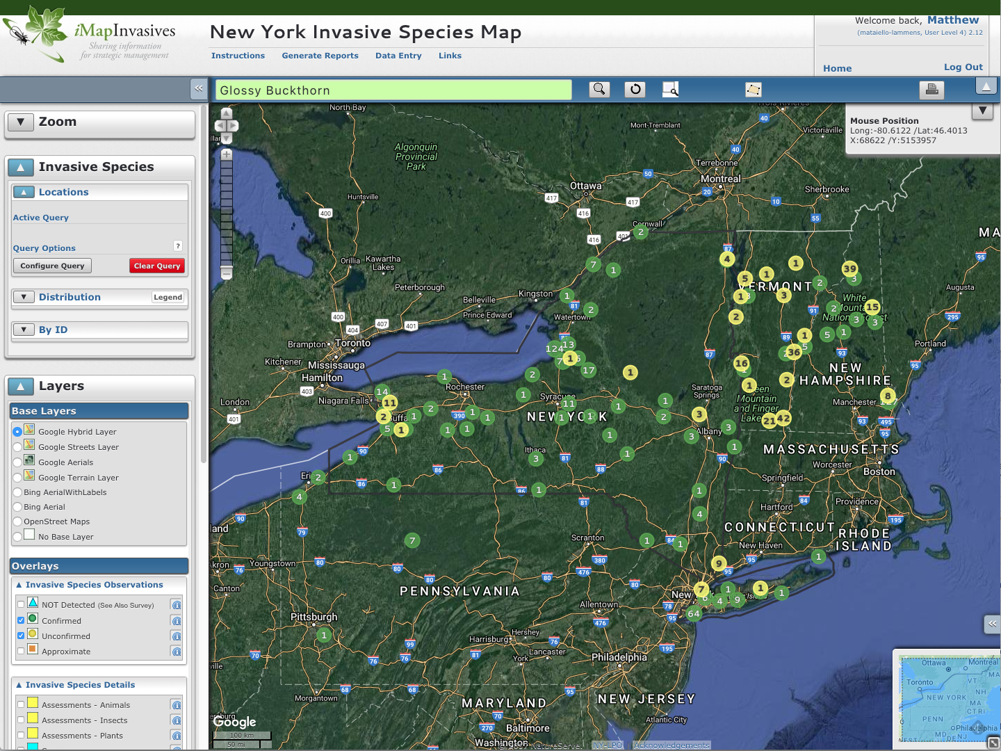

Slide 31
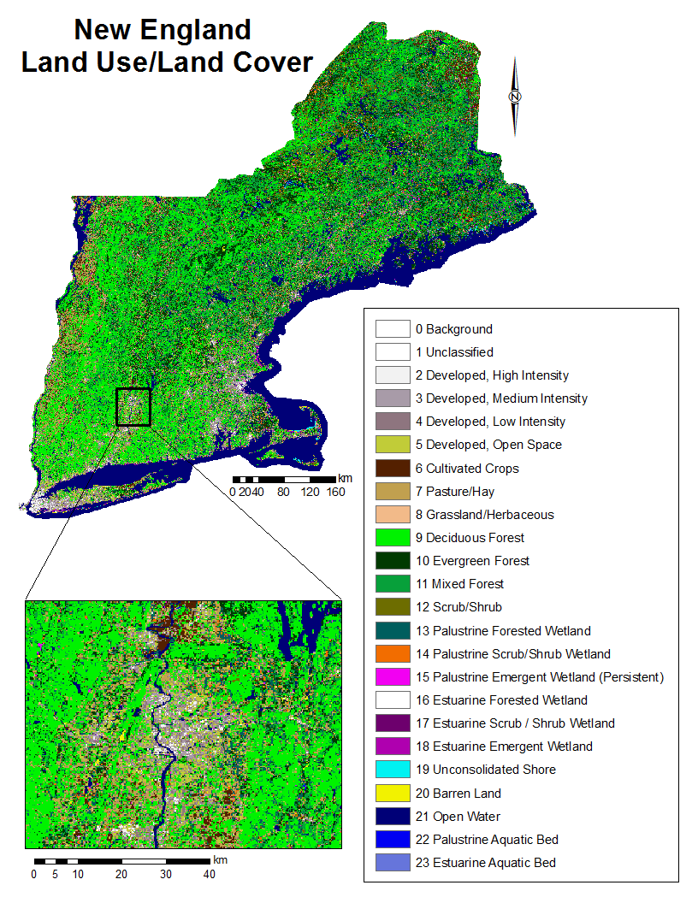
Land-use/Land-cover (LULC): for northeast
These are derived from satellite images that have been classified into a suite of standardized land-use types (20-40 types).
30m grid cell resolution from Landsat satellites

Slide 32
Uses of species distribution models
The data required to construct these models are relatively easy to get
On-line databases like EDDMaps, iNaturalist, iMapInvasives
Climate layers easy to get, other environmental variables also accessible
Inform predictions of future invasions
Where might a species become established?
How might climate change influence invasions?

Slide 33
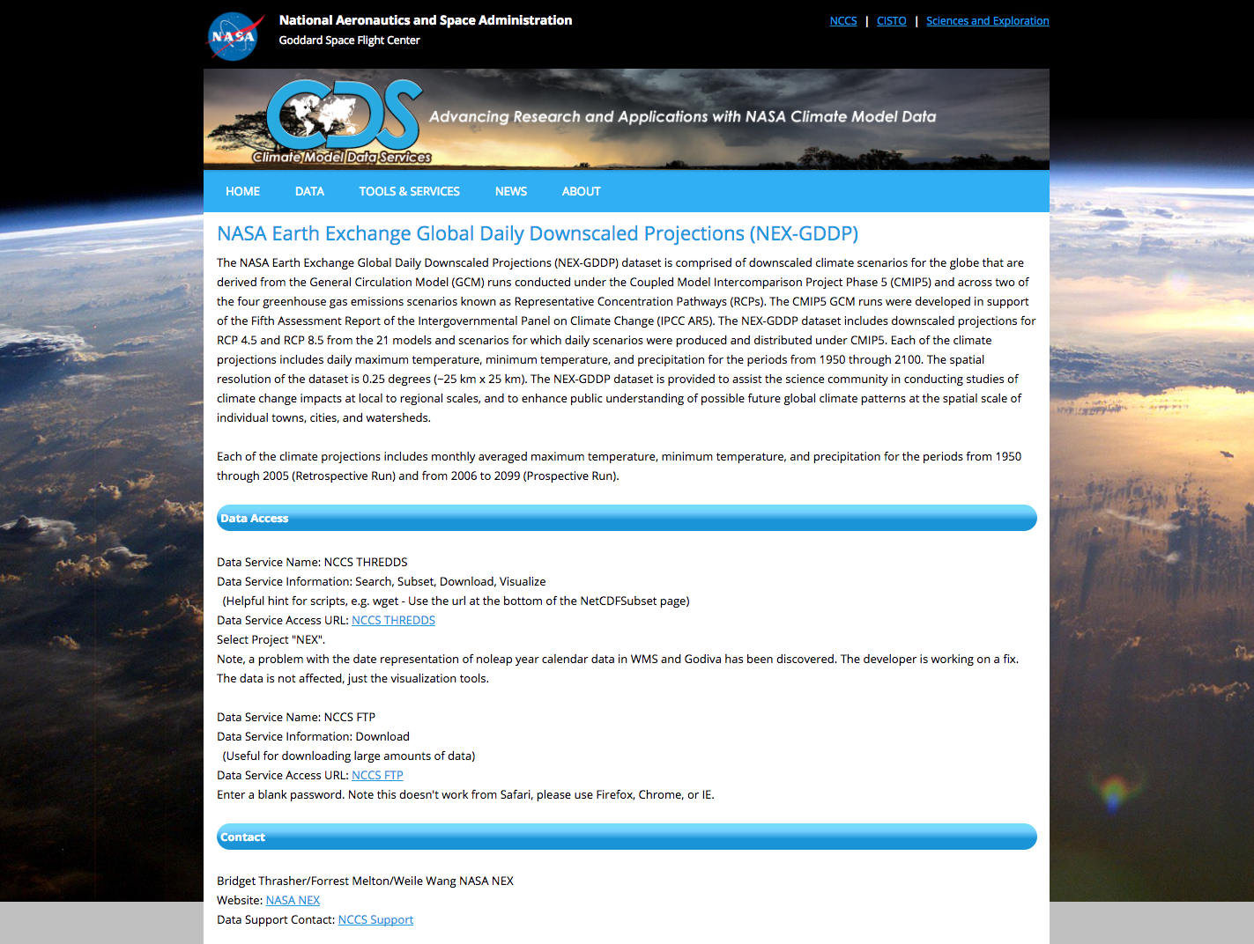

Slide 34
CURRENT distribution of buckthorn
GB Suitability ~
Mean Annual Temperature + Total Precipitation + …

Slide 35
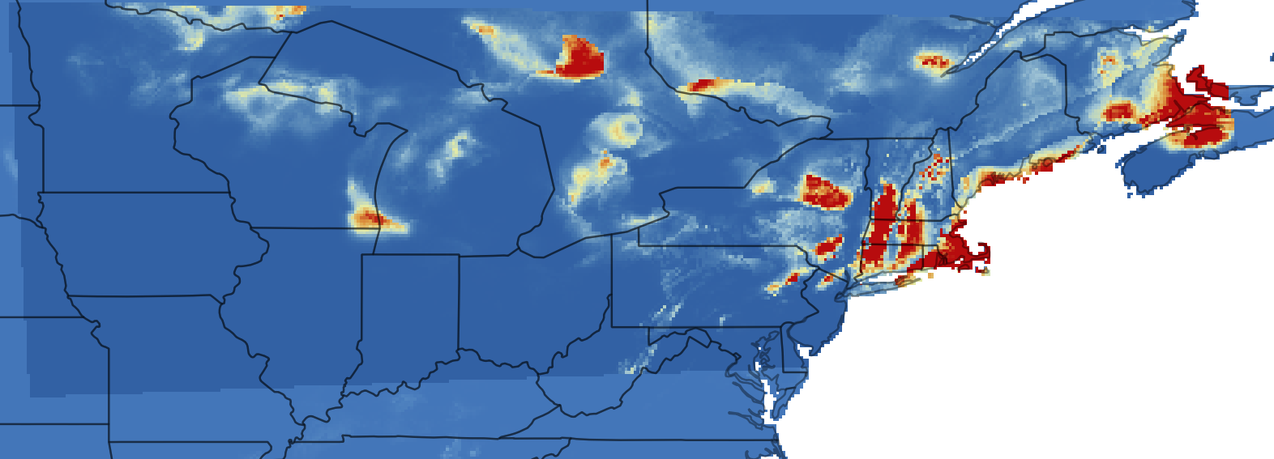
FUTURE distribution of buckthorn
Future GB Suitability ~
Future Mean Annual Temperature + Future Total Precipitation + …

Slide 36
Aralia elata (Japanese Angelic Tree)
Preference for high light, recently disturbed sites
“Highly armored”
Notes:
This is also very often given as one reason buckthorn has spread so rapidly in the novel range

Slide 37
Aralia elata (Japanese Angelic Tree)
Assumed that fruit are bird dispersed
In area since 1800s, but noticed as invasive “recently” (NYBG 1897)
Notes:
This is also very often given as one reason buckthorn has spread so rapidly in the novel range

Slide 38
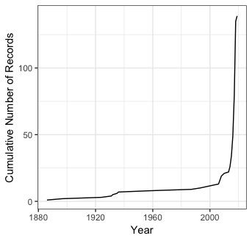
Aralia elata (Japanese Angelic Tree)
Notes:
This is also very often given as one reason buckthorn has spread so rapidly in the novel range

Slide 39
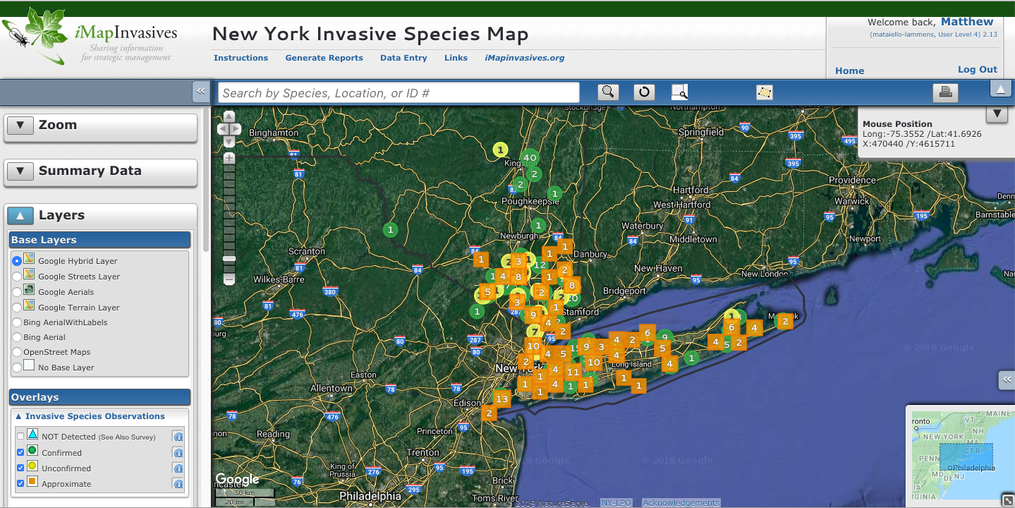
Angelica Tree – Current Distribution

Slide 40
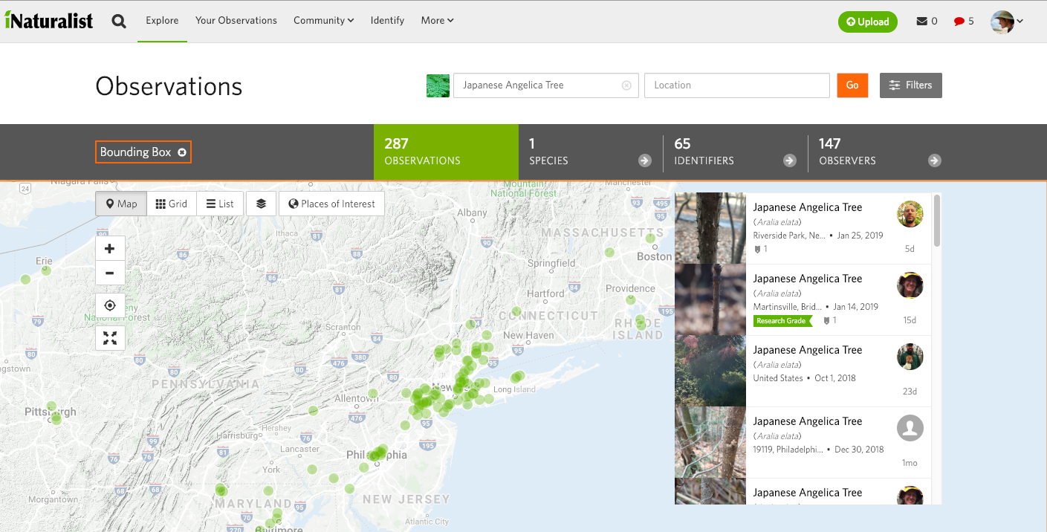
Angelica Tree – Current Distribution

Slide 41
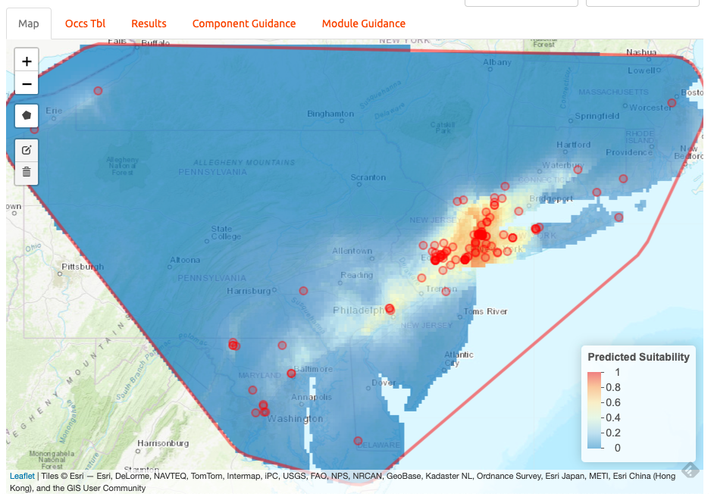
Angelica Tree – Potential Distribution
Distribution model results using documented eastern iNaturalist locations

Slide 42
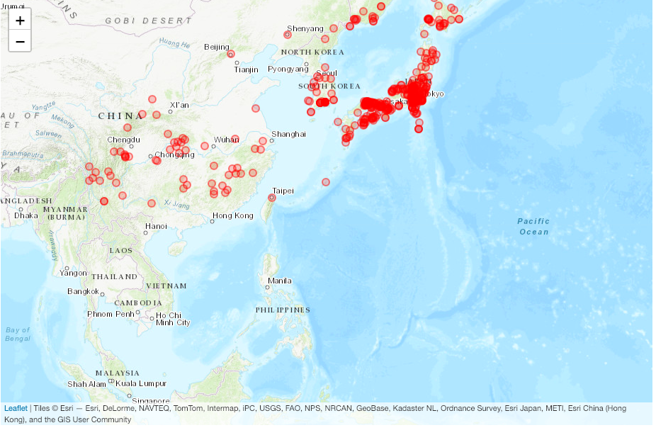
Angelica Tree – Potential Distribution
Documented native range locations

Slide 43
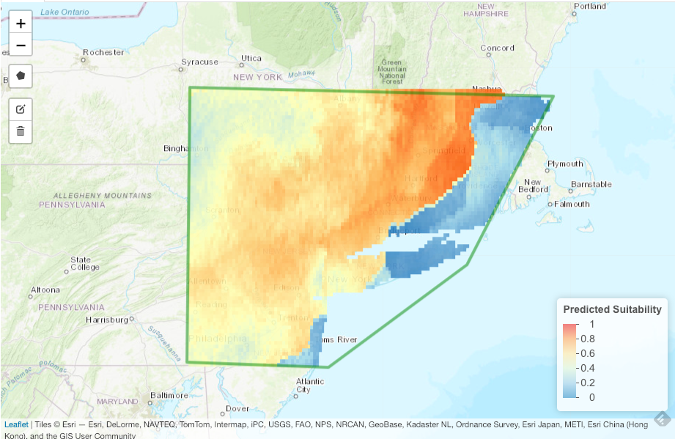
Angelica Tree – Potential Distribution
Distribution model results using documented native range locations

Slide 44
Angelica Tree – Potential Distribution
Maybe this is where we should be worried?
Distribution model results using documented native range locations

Slide 45
Glossy Buckthorn – word of warning

Slide 46
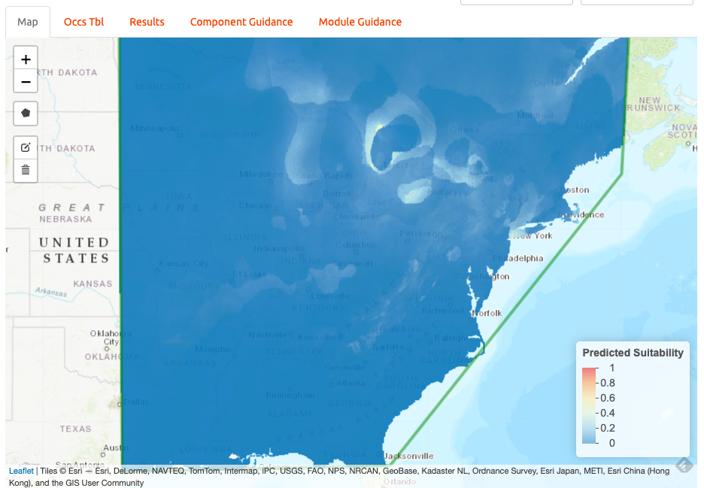
Glossy Buckthorn – word of warning

Slide 47
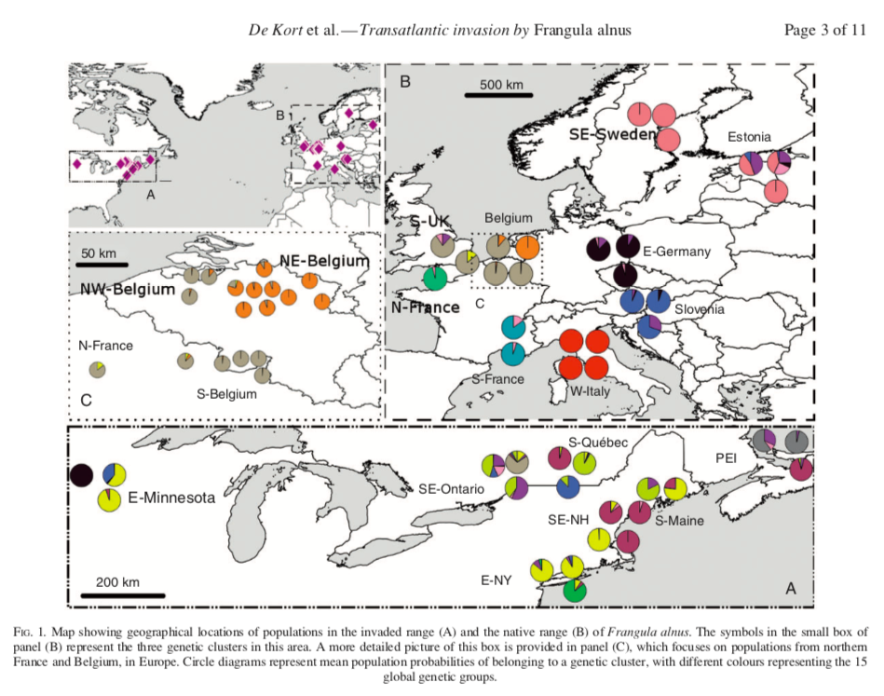
Glossy Buckthorn – word of warning

Slide 48
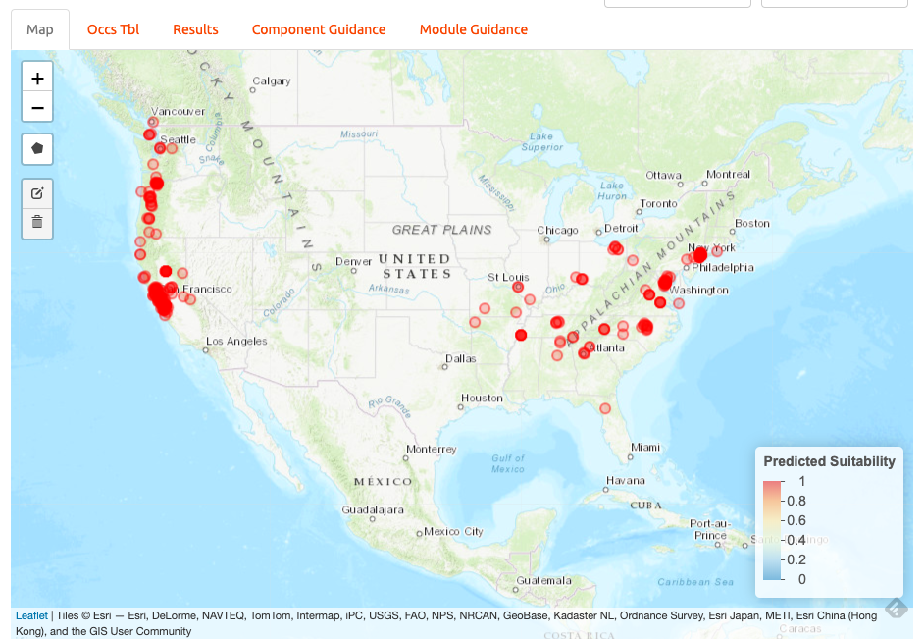
Italian Arum – Current Distribution

Slide 49
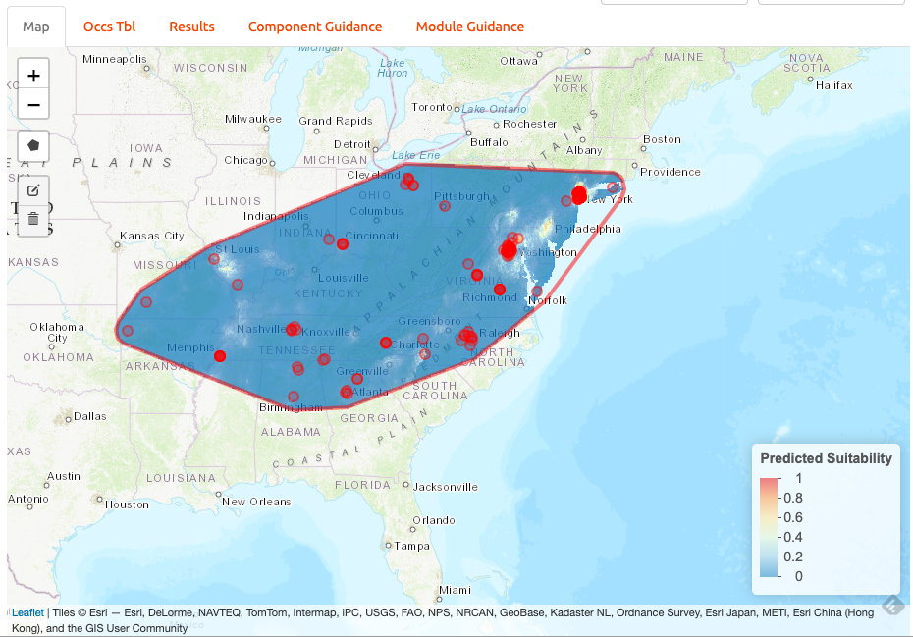
Italian Arum – Potential Distribution

Slide 50
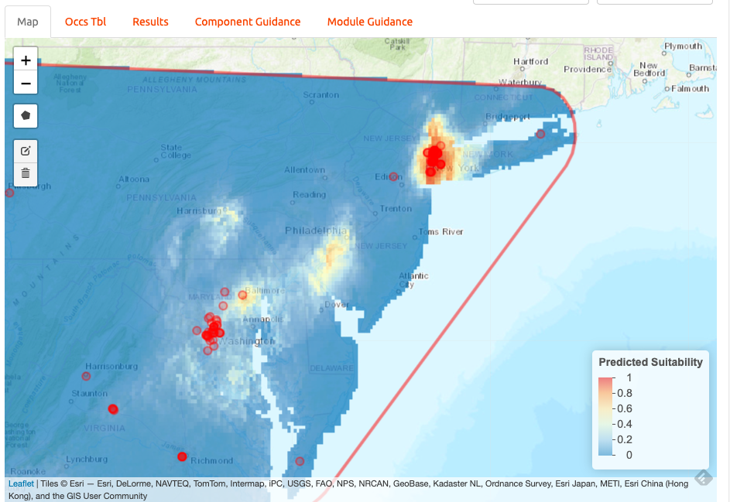
Italian Arum – Potential Distribution

Slide 51
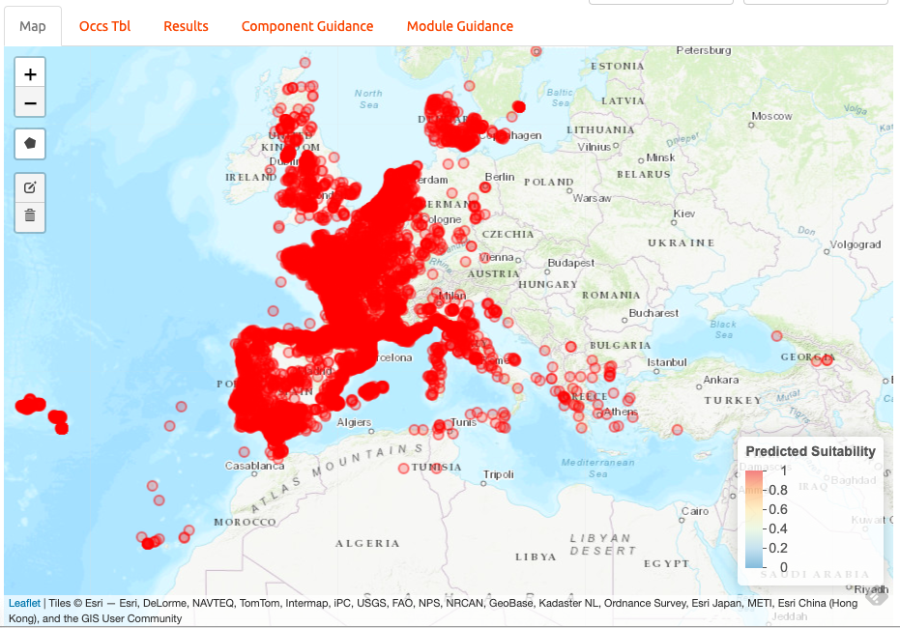
Italian Arum – Native Distribution

Slide 52
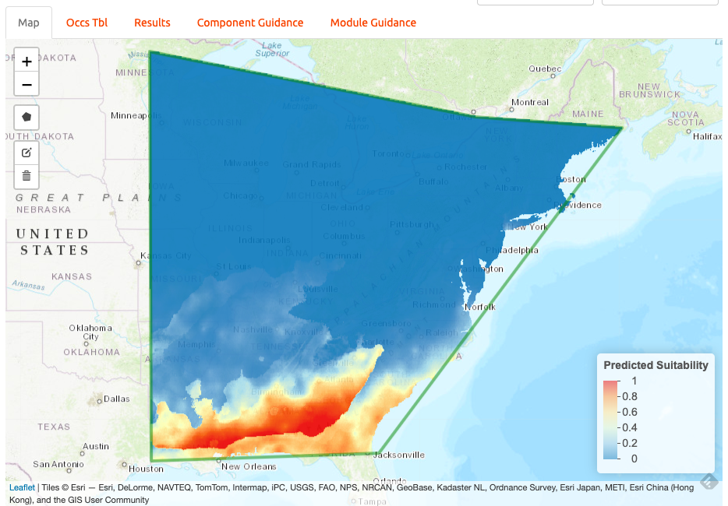
Italian Arum – Potential Distribution

Slide 53
Italian Arum – Potential Distribution
Maybe this is where we should be worried?

Slide 54
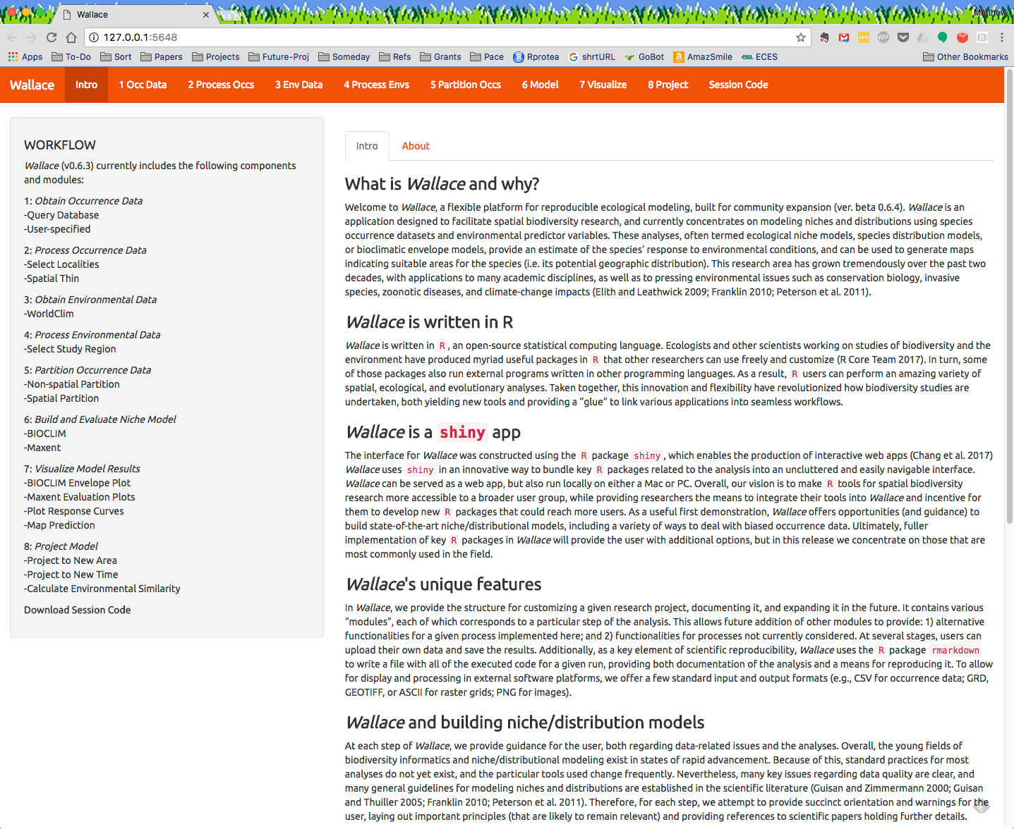
These models constructed in Wallace – an R package designed to implement and teach best practices in distribution modeling
https://wallaceecomod.github.io/

Slide 55
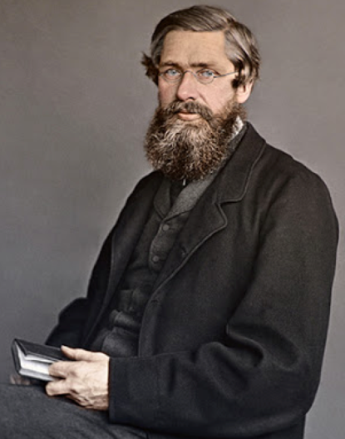
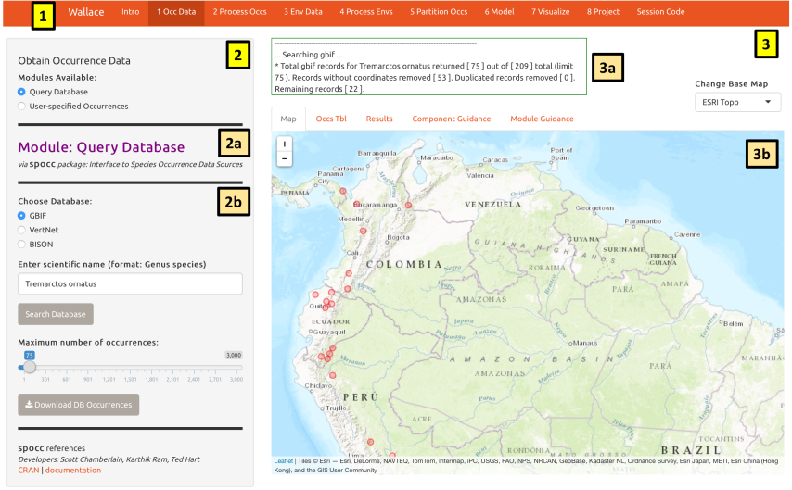
Wallace
What is Wallace? And Why?
What is Wallace not?

Slide 56




Range estimates needed

Slide 57
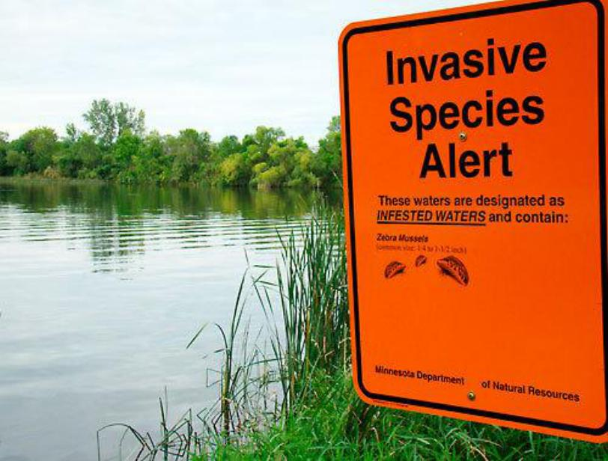
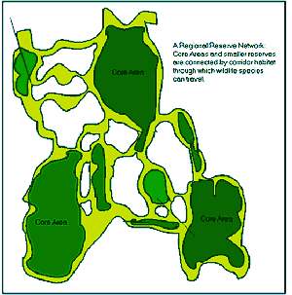

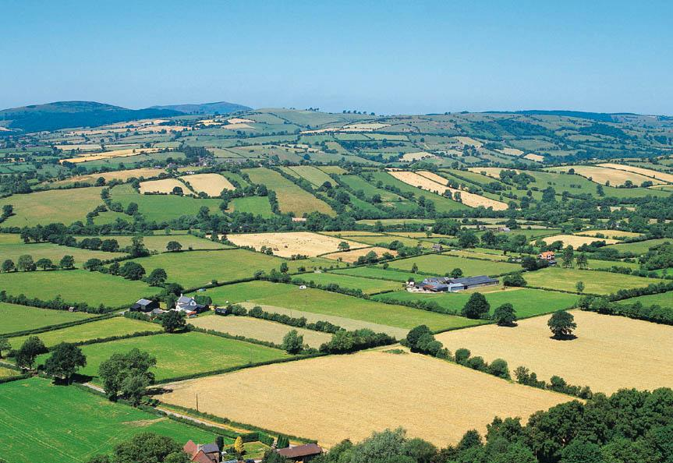
Range estimates needed
Reserve planning
Invasive species
Land-use policies
Zoonotic diseases

Slide 58
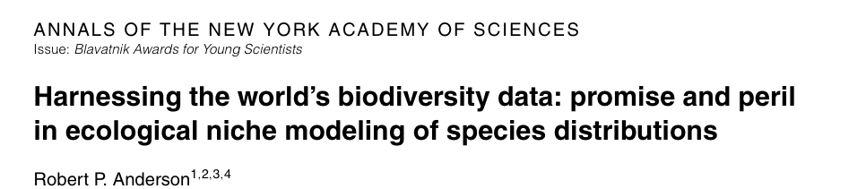
Agenda: applied biodiversity informatics
1. High-quality data, ready to be accessed when the particular problem presents itself
2. Software that achieves an appropriate balance between automation and supervision
3. Scientists capable of building, applying, and appraising high-quality models

Slide 59
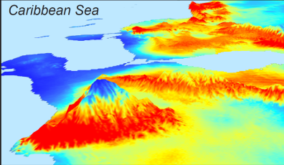
Correlative modeling of species niches and ranges
Occurrence records
Suitable areas
Model of niche
Algorithm
Environmental data

Slide 60
Correlative modeling of species niches and ranges
another place
Occurrence records
Suitable areas
Model of niche
Algorithm
Environmental data
another time
Conservation, invasive species, zoonotic diseases, climate change

Slide 61
Agenda: applied biodiversity informatics
Anderson (2012)
Software that achieves an appropriate balance between automation and supervision
automates repetitive aspects
forces user to make critical biological and conceptual decisions
general with respect to algorithms used

Slide 62
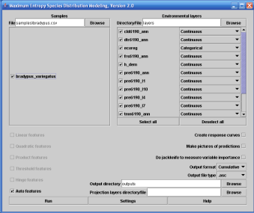
Problems with existing analyses
Existing GUIs
(too) easy
default settings
inflexible
infrequently updated
strings of applications

Slide 63
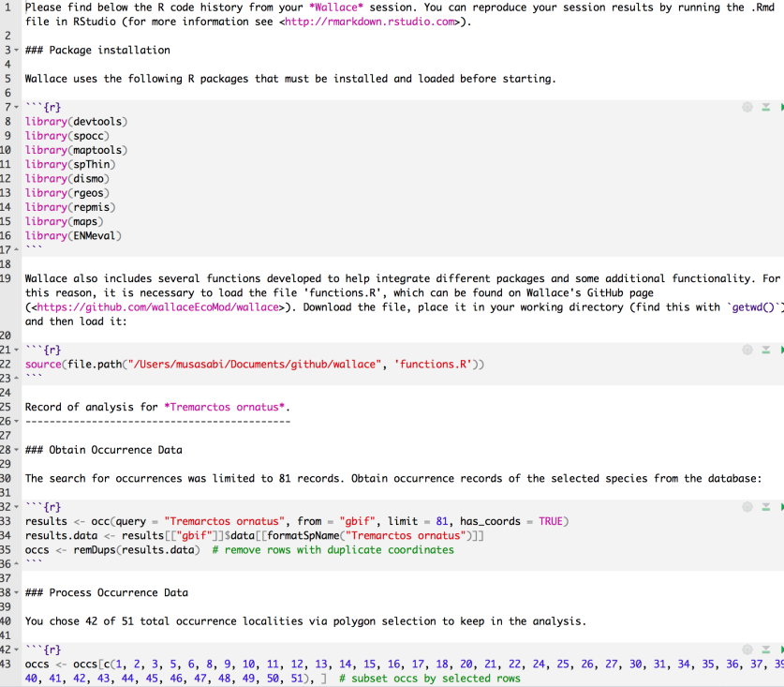
Problems with existing analyses
Existing GUIs
(too) easy
default settings
inflexible
infrequently updated
strings of applications
Code
error-prone
not easily generalizable
slow to be taken up

Slide 64
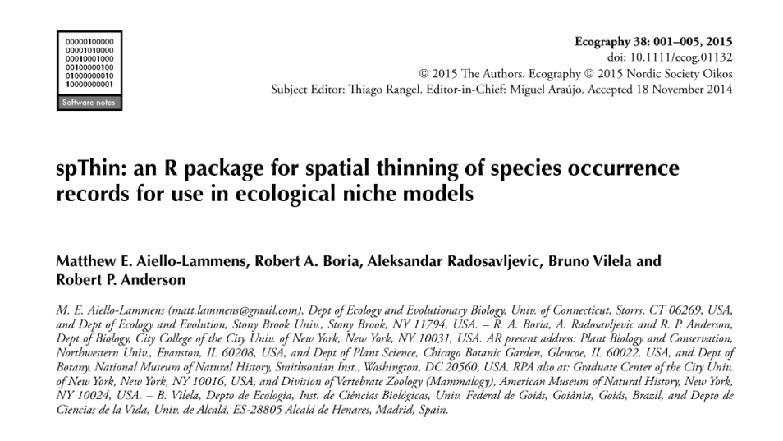
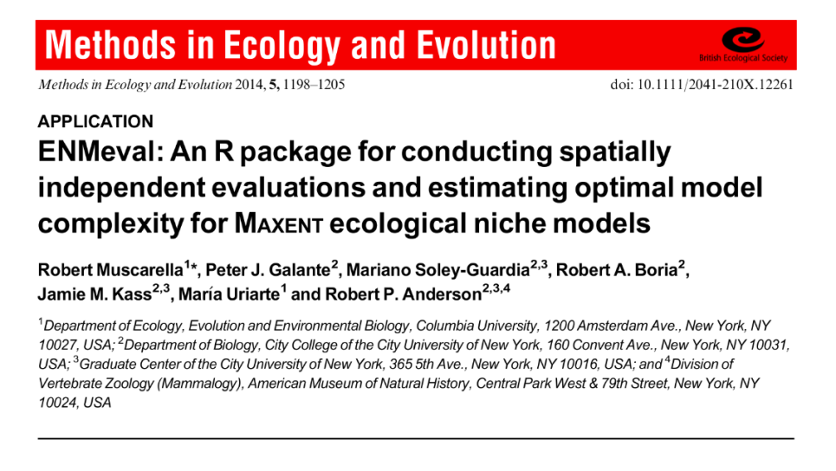
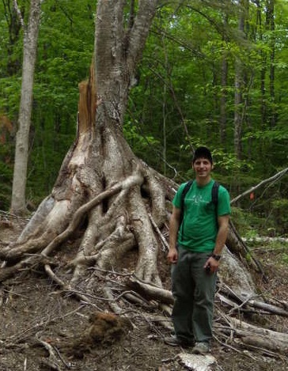

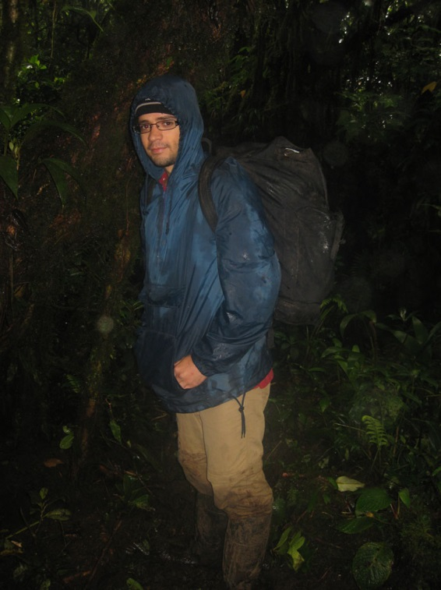


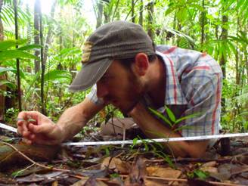




Recent-ish R packages: spThin and ENMeval
Matthew Aiello-Lammens
Robert Muscarella
Robert Anderson, Robert Boria, Peter Galante, Jamie Kass,
Aleksandar Radosavljevic, Mariano Soley-Guardia, Maria Uriarte, Bruno Vilela

Slide 65


From R to a GUI
Innovative use of GBIF occurrence data

Slide 66

Combine code-based methods with GUI
Foreground:
Flexible, interactive, expandable GUI
Background:
R code from new packages: reproducible

Slide 67
















Slide 68








Ever-expanding Wallace contributors
Jamie M. Kass, Bruno Vilela, Matthew E. Aiello-Lammens, Robert Muscarella, Cory Merow & Robert P. Anderson
… and Mary E. Blair, Ned Horning, Jorge Velásquez-Tibatá, Gonzalo E. Pinilla-Buitrago, Beth E. Gerstner & Sarah I. Meenan
… and Olivier Broennimann, Brian S. Maitner, Hannah L. Owens & Sara Varela

Slide 69

What is Wallace NOT?
A full replacement for general GIS software
A software that is perfect
A software that does EVERYTHING you want to study niches and distributions

Slide 70
What is Wallace?
Point-and-click (GUI) application that includes most steps of a niche/distribution modeling workflow
Harnesses R packages and gives credit to their authors
Currently expanding …

Slide 71





Slide 72

Installing Wallace
Install R (and optionally Rstudio) and Java
Install the wallace package from CRAN
OPTIONAL: For Maxent, install maxent.jar (https://biodiversityinformatics.amnh.org/open_source/maxent/ and place in dismo folder
Troubleshooting on Github page (https://github.com/wallaceEcoMod/wallace)

Slide 73

Qualities of Wallace
Wallace’s code is free and open
(& users can download data from online databases.)

Slide 74

Qualities of Wallace
Wallace provides guidance
that addresses conceptual and methodological issues.

Slide 75

Qualities of Wallace
Wallace is flexible
by providing multiple options, and allowing user inputs and downloads for most components.

Slide 76

Qualities of Wallace
Wallace features interactive
maps, tables, and graphs to explore data and model predictions.

Slide 77
Qualities of Wallace
Wallace is reproducible
by providing executable code for documenting and rerunning the analysis.

Slide 78

Qualities of Wallace
Wallace is expandable!
by featuring different methodological options (modules) that researchers can contribute to advance functionality.

Slide 79

Qualities of Wallace

Slide 80
Qualities of Wallace

Slide 81
Qualities of Wallace

Slide 82

Wallace today
1. Full Release 1.0.6 (Kass et al. 2018, Methods in Ecology & Evolution software note; Google group; Wallace e-mail)
NSF DEB-1119915 & DBI-1650241

Slide 83

Wallace today
1. Full Release 1.0.6 (Kass et al. 2018, Methods in Ecology & Evolution software note; Google group; Wallace e-mail)
2. New NSF funding to work with external partners to add new modules
NSF DEB-1119915 & DBI-1650241
NSF DBI-1661510

Slide 84

Wallace today
1. Full Release 1.0.6 (Kass et al. 2018, Methods in Ecology & Evolution software note; Google group; Wallace e-mail)
2. New NSF funding to work with external partners to add new modules
3. New NASA funding, led by Mary Blair (AMNH), to develop new R packages and add them to Wallace and interface with BioModelos
NSF DEB-1119915 & DBI-1650241
NSF DBI-1661510
Mary E. Blair, Ned Horning, Jorge Velásquez-Tibatá, Gonzalo E. Pinilla-Buitrago, Beth E. Gerstner, Peter J. Galante & Sarah I. Meenan
NASA 80NSSC18K0406

Slide 85
Current Wallace Development
Addressing Github Issues, Google Group posts
Fixing bugs, making enhancements
Working on version 2.0.0, which can perform analyses on SDMs for multiple species (niche overlap, PCA, etc.)
Still inviting collaborators to add new modules
Working on making module ingestions easier

Slide 86
Installing Wallace
Install R (and optionally Rstudio) and Java
Install the wallace package from CRAN
OPTIONAL: For Maxent, install maxent.jar (https://biodiversityinformatics.amnh.org/open_source/maxent/ and place in dismo folder
Troubleshooting on Github page (https://github.com/wallaceEcoMod/wallace)

Slide 87







THANK YOU
Anderson lab (chronosequence)
https://wallaceecomod.github.io/
http://www.andersonlab.ccny.cuny.edu

